Slide 1
OCCUPATIONAL HEALTH AND SAFETY IN HEALTH CARE SETTINGS
IPC and Patient Safety Training
Ethiopia

Slide 2
Learning Objectives
Outline considerations for specific groups of HCW
Elaborate how to manage occupational exposure
Explain Post Exposure Prophylaxis for HIV and HBV
Explain risks and work restrictions for HCWs infected with HIV/Hepatitis
Outline occupational health monitoring activities
Outline key elements of an occupational health program in healthcare facilities
Explain Hazard Identification, Risk Assessment and Risk Control
Elaborate on prevention and management of infections in HCWs
Explain management of Job-related Illnesses and Occupational exposures
List Prevention Strategies for occupational

Slide 3
Presentation Outline
Key elements of Occupational health program
Hazard Identification, Risk Assessment and Risk Control
Prevention and management of infections in HCWs
Management of job-related illnesses and occupational exposures
Prevention strategies for Occupational infections
Occupational health activities for specific groups of HCWs
Post Exposure Prophylaxis for HIV and HBV
Monitoring of occupational health activities
Risks and work restrictions for HCWs exposed to or infected with infectious diseases

Slide 4
Introduction
Occupational health deals with all aspects of work-related health and safety and has a strong focus on prevention, especially for infectious (such as disease exposures) and non-infectious risks (such as injury)
IPC and Occupational Health goals are interlinked in preventing and addressing infectious hazards
IPC staff should be involved in occupational health activities and occupational health staff should be knowledgeable about IPC
IPC elements of an occupational health program include
  Surveillance, Education, Immunization, exposure prevention and response

Slide 5
Introduction (contd.)
Risk of acquiring or transmitting infections increases with patients, body fluids, or specimens contact
Worldwide, occupational exposure to sharps injuries causes an estimated;
  39% of hepatitis C virus (HCV)
  37% of hepatitis B virus (HBV)
  4.4% of HIV infections among HCWs worldwide
HBV is 95% preventable with immunization

Slide 6
Key elements of occupational health programs in health care facilities
• Oversight by a qualified healthcare professional/team
• Coordination among multiple hospital departments
• Medical evaluation at the start of employment
• Health and safety education/training of all staff
• Immunization programs
• Management of work restrictions and post-exposure treatment for occupational illnesses and exposures
• Counseling on protection from and management of accidental exposure to blood-borne and other infectious pathogens
• Maintenance of personnel health records

Slide 7
  Hazard Identification, Risk Assessment and Risk control
When?
Workplace hazard identification, assessment and control are on-going processes
Specific times include when;
  its not been done before
  hazard has been identified
  a change to the workplace may introduce a hazard
  responding to a workplace incident
  new information about a risk becomes available
  concerns are raised by workers
  scheduled at regular intervals

Slide 8
Hazard Identification
This is the process of examining each work area and work task for the purpose of identifying all the hazards which are “inherent in the job”
Work area:
  Wards, laboratories, offices, stores, teaching spaces etc
Tasks:
  Assessment, diagnostic, treatment procedures; dealing with people, hazardous substances, emergencies etc
Process
  Finding what could cause harm in work, task or area

Slide 9
Risk Assessment
Defined as the process of assessing the risks associated with each hazard identified, so the nature of the risk can be understood;
To Understand ;
  The nature of harm that may result from the hazard
  The severity of that harm
  The likelihood of this occurring.

Slide 10
Risk Control
Definition- Reasonable, practicable actions to eliminate health and safety risks
Where risks cannot be eliminated
  implementation of control measures to minimize risks
Class discussion
  Give examples of situations where risk cannot be eliminated and how to minimize the risks

Slide 11
Monitoring and Review
Involves ongoing monitoring of the hazards identified, risks assessed and risk control processes and reviewing them to make sure they are working effectively.
Check effectiveness of control measures through regular reviews and consultation with workers

Slide 12
Preventing Occupational Infections
Remember!
  The goal is to protect HCWs, thereby their patients from acquiring an infection or any other hazard while working in a healthcare facility
How?
Identifying/preventing work-related infection risks
Ensuring prompt and appropriate management of occupational exposures
Training HCWs on IPC and patient safety practices
Monitoring and investigating potentially harmful exposures and outbreaks among HCWs

Slide 13
Management of Job-related Illnesses & Exposures
The occupational health team should ;
  respond to all potential and confirmed exposures to blood-borne pathogens and other infectious diseases immediately
  collaborate with IPC staff for follow-up as necessary
Health care facilities should have systems in place for HCWs to report sharps injuries and blood-borne pathogen exposures with prompt evaluation and follow-up

Slide 14
Management of Job-Related Illnesses & Exposures
Infectious disease in HCWs;
Identify infections in HWs (community-acquired or job-related)
Make evidence-based decisions about the length and type of work restrictions
Report to public health authorities, if it is a notifiable disease of public health interest

Slide 15
Management of Job-Related Illnesses & Exposures
Sentinel infections in HCWs
Suspect a job-related infection in HCW with an infectious disease known to spread in health care facilities
Manage by clinical guideline and apply necessary length/type of work restrictions
Prevent further spread of the infection through investigation of possible routes of transmission in the facility and correcting any IPC lapses
Identify and facilitate clinical management of those exposed
Monitor closely for additional cases (indicating a hospital or community outbreak).

Slide 16
Management of Job-Related Illnesses & Exposures
Post-exposure follow-up
Define exposure
Obtain list of exposed persons
Counsel those exposed
Offer PEP promptly when appropriate and available
Determine any work restrictions
Conduct medical surveillance for development of disease
Determine when the HCW can return to work
Maintain adequate and confidential documentation on the event
Coordinate all of the above and any other activities such as ongoing monitoring or follow-up lab testing

Slide 17
Occupational Infections; Prevention Strategies
Prevent occupational exposure of HWs by application of:
Standard Precautions for all patients, at all times
Disease-specific or Transmission-Based Precautions
Protect against vaccine-preventable diseases:
Provide vaccines to HWs to protect against vaccine-preventable diseases
Prioritize staff that are at high risk of exposure & those without immunity
Select the vaccines that may provide the most protective effects
Manage occupational exposures:
Follow national guideline for post-exposure management e.g. HBV, HCV, and HIV
Keep up-to-date
Seek additional information on specific diseases and local epidemiology

Slide 18
Occupational Health Activity Considerations
Facility occupational health priorities depend on;
  type of facility,
  organizational structure
  services provided
  geographical location
  characteristics of the patients and HCWs
  diseases that are endemic in the community.
Occupational health activities should include activities for;
  newly employed HCWs
  HWs on an ongoing basis
  entire facility
  those that may need special attention; e.g. pregnant staff, laboratory staff, emergency response staff, and HCWs infected with HIV, HBV, or HCV.

Slide 19
Pregnant HCWs
Pregnancy does not increase the risk of infection for most occupationally acquired infections (APIC 2014b)
OH staff should address any questions / concerns that pregnant HCWs may have
Standard & Transmission-Based Precautions, should be adequate for pregnant HCWs in preventing most infectious diseases
However, non-immune pregnant HCWs should not care for patients with measles, rubella, and varicella (APIC 2014b)

Slide 20
Laboratory Staff
HCWs in laboratories may be at increased risk of occupational exposure to the pathogens with which they work.
Laboratory staff should receive specific training on the risks and how to prevent infections
In addition to the vaccines routinely recommended for all HCWs, further vaccinations may be appropriate for HCWs working in a clinical or research laboratory (CDC 1998).
The following vaccines may be relevant for staff working with specific pathogens:BCG (Mycobacterium tuberculosis), Hepatitis A, Meningococcal (N. meningitidis), Polio, Rabies and Typhoid (CDC 1998)

Slide 21
Emergency Response Staff
Occupational Health considerations;
High risk of exposure to highly infectious pathogens
May transport patient before the infection status is known (e.g., meningococcal meningitis, novel respiratory viruses, VHF)
Should have relevant vaccinations
Proper IPC training/supervision (Standard , Isolation/Transmission-based precautions)
Should gave adequate PPE and other IPC supplies /facilities
Should be informed about patients who later develop infections of occupational health concern
Should be included in exposure follow-up and relevant PEP and work restrictions

Slide 22
HCWs exposed to HIV and/or Hepatitis B or C
HIV, HBV and HCV are transmitted via
  exposure to body fluids percutaneous injury
  contact of mucous membranes or non-intact skin with blood with fluids containing blood, tissue or other potentially infectious bodily fluids
Potentially infectious body fluids include semen, vaginal secretions, cerebrospinal fluid, synovial fluid, pleural fluid, peritoneal fluid, pericardial fluid, amniotic fluid, pus, etc.
In this case, body fluids like feces, nasal secretions, saliva, sputum, sweat, tears, urine, and vomits are not considered infectious unless they contain blood

Slide 23
HCWs exposed to HIV and/or Hepatitis B or C
Occupational Exposure
  Exposure of individuals to HIV and other blood borne pathogens occurring in the course of their work
  Such exposure may be directed to HCWs, and other staff; cleaners etc
  Exposure to blood-borne pathogens involves skin, eye, mucous membrane, or par-enteral contact (e.g., a needle stick).

Slide 24
HCWs exposed to HIV and/or Hepatitis B or C
Non-Occupational Exposure
  This is an exposure to HIV and other blood borne pathogens outside the work setting
  E.g. sexual assault, consensual sex, needle sticks or sharing in the community, fights or playground incidents resulting in bleeding by an HIV-infected child and mass causalities like road traffic accidents, etc.

Slide 25
Post Exposure Prophylaxis for HIV And HBV
Occupational Exposure to HIV
Treatment with ARVs soon after exposure to HIV decreases the risk of transmission.
Based on different study results:
  PEP with AZT for 4 weeks was associated with an 81% reduction in transmission of HIV in humans
  PEP is effective when initiated within 72 hours of exposure
  PEP drugs recommended started for exposed persons as early as possible preferably within 2 hours of exposure but PEP after 72 hours of exposure is not advisable.

Slide 26
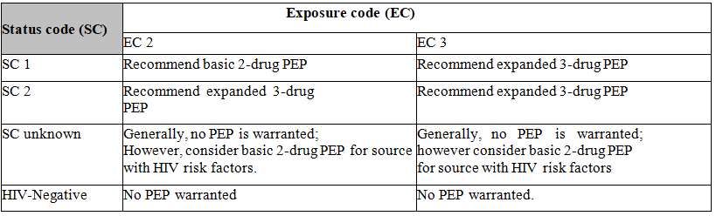
Recommended HIV Post Exposure Prophylaxes (PEP) for Percutaneous Injuries

Slide 27
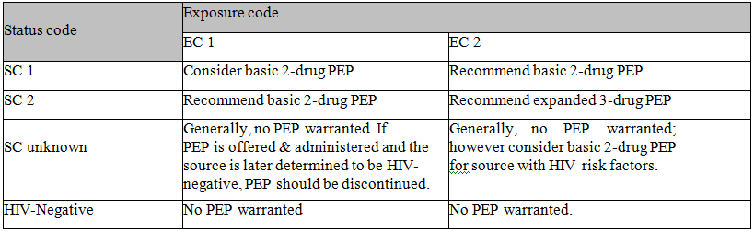
Recommended HIV Post Exposure Prophylaxes for Mucous Membrane Exposures and Non-intact Skin Exposures

Slide 28
Adherence
Compliance rates of 95% or greater are required to maximize the benefits of ARV therapy.
Phone call s can be useful to follow-up those who have started
The service given at each follow up visit should be documented
Use standard tools to facilitate counseling and informed decision making
Patients given PEP drugs should be counseled on side effects of ARVs

Slide 29
PEP for Pregnant Women and Women of Childbearing Potential and children
Efavirenz should not be used in any nPEP (Non-Occupational PEP) regimen during:
  pregnancy or among women of childbearing age at risk of becoming pregnant
  consider giving protease inhibitor or nucleoside reverse transcriptase inhibitor-based regimen.
Children
Potential HIV exposures in children occur:
  Due to accident (e.g. needle sticks, in the community, fights, or playground incidents resulting in bleeding by an HIV-infected child)
  Due to sexual abuse or assaults
Given appropriate pediatric preparations
Involvement of parents or guardians, and support provided is key for adherence

Slide 30
Exposure to Hepatitis B Virus
HBV infection is a well-recognized occupational risk for HCW
Primarily related to the degree of contact with blood and also to hepatitis B e antigen (HBeAg) status of the source person
It is recommended that healthcare workers should be vaccinated for HBV

Slide 31
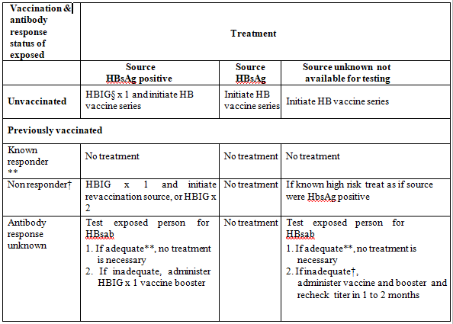
Recommended Post-exposure Prophylaxis for Exposure to Hepatitis B Virus

Slide 32
Exposure To Hepatitis C Virus
HCV is rarely transmitted from mucous membrane exposure to blood
it has not been documented to occur as a consequence of a blood exposure to intact or non-intact skin
Therefore, there is no known PEP to HCV exposure
Follow-up testing is recommended for an exposure to HCV with anti-HCV antibody testing within 4 to 6 months.
  If result is positive antibody test, conduct HCV viral load and liver function tests
  Once exposure is confirmed, the management and follow up of non-occupational HCV exposure is similar to that of the occupational exposure

Slide 33
Post-Exposure Management Steps (HBV, HCV and HIV)
The aim of post-exposure reporting and follow-up is to start PEP as soon as possible, within 72 hours of exposure, if indicated

Slide 34
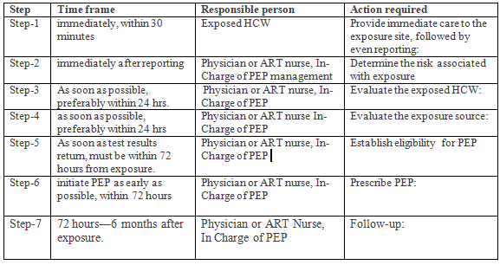
Managing occupational exposure to blood-borne pathogens

Slide 35
Documentation of PEP Services
Each person with occupational HIV exposure should report the incidence to his immediate supervisor
Initial PEP management should be given within the case team and the exposed person is referred to the ART clinic for further follow up
Documentation of exposure and management given should be done by using potential HIV exposure documentation and follow up form which would be attached with the patient chart.

Slide 36
Documentation Of PEP Services
The person who gives PEP service should:
Be trained on PEP service delivery (or a training with a PEP management component)
Be responsible for completing the potential HIV exposure documentation and follow up form
Attach follow-up form with the patient chart
Utilize the PEP decision- making tools (job aid) to determine indications for PEP and decide on the use of two or three drug regimens

Slide 37
Documentation of PEP Services
If PEP is not indicated, the PEP trained service provider (preferably case team leader):
Will file the completed Potential HIV exposure documentation and follow up form with the patient chart
Indicate to the exposed person that no further follow-up is needed
The incident and the service given should also be documented on service register in the service outlet

Slide 38
At the ART clinic
The person getting PEP service:
  will have a minimum of six follow up visits and
  each time come with HIV exposure documentation and follow up form
  the patient’s chart and the PEP register placed in the ART clinic are updated
Documentation and reporting of PEP service given for non occupational exposure will be similar to that of occupational exposure.

Slide 39
Class discussion
Has your facility had any experience with occupational exposure to blood-borne pathogens
  Share how the situation was handled
  Discuss ways to improve management these

Slide 40
HCWs Infected with HIV and/or Hepatitis B or C
HCWs infected with HIV and/or HBV or HCV should inform the facility manager of their status
The facility IPC team should strive to prevent transmission of infections to patients and at the same time maintain the livelihood and privacy of the infected staff members
These HCWs should not be prohibited from providing patient care if
  they are not performing invasive procedures
  the infection is well-controlled
  they fully comply with recommended IPC practices, and
  there are no other factors that would prevent them from safely carrying out the patient care activities.
Close follow-up of these HCWs, by a team of clinicians is critical
They should avoid performing procedures that may result in increased risk of contact with large amounts of blood and body fluids
No restrictions for those staff with viral loads less than designated levels

Slide 41
Managing HCWs infected with HIV and/or hepatitis B or C
HCWs infected with blood-borne pathogens whose viral load is below the minimum designated level should follow the plan described below to safely provide patient care and be productive
The HCWs should:
Not transmit infection to any patient
Obtain advice from a team of clinicians about continuing to care for patients
Undergo testing twice a year to demonstrate the maintenance of a viral burden below designated levels
Receive follow-up by a clinician with expertise in managing blood-borne pathogen infections and consent to share their results with the IPC/occupational health team at the facility
Consult closely with experts on the use of optimal IPC procedures:
  This may include guidance on double gloving, changing gloves during procedures, avoiding digital palpation of needle tips, and performing all procedures under direct view.
  It also includes promptly withdrawing from a procedure if they have any injury that bleeds and informing the IPC/occupational health team about any injuries
Agree in writing to comply with recommendations and guidance of the expert clinicians as well as the facility IPC/occupational health and management team

Slide 42
Monitoring Prevention of Occupational Exposures and Injuries
Health care facilities should
  evaluate the effectiveness of occupational health interventions and practices on a routine basis
  conduct surveillance to collect, analyze, and disseminate data on risks to HCWs
  have a system to report any occupational exposure and injury,/prompt management and PEP
  review the rates of injuries or exposures among HCWs
  feedback to the staff
  develop/update strategies and action plans to prevent future injuries
Surveillance activities can be conducted by the staff working on occupational health activities and/or IPC staff

